Slide 1
DCC-CR workshop Integrated Coastal Management and Marine Spatial Planning in support of Coastal Resilience Sea’ties – Accelerating just and equitable adaptation in coastal cities
Lisa Devignol
ldevignol@ocean-climate.org
18/01/2023

Slide 2
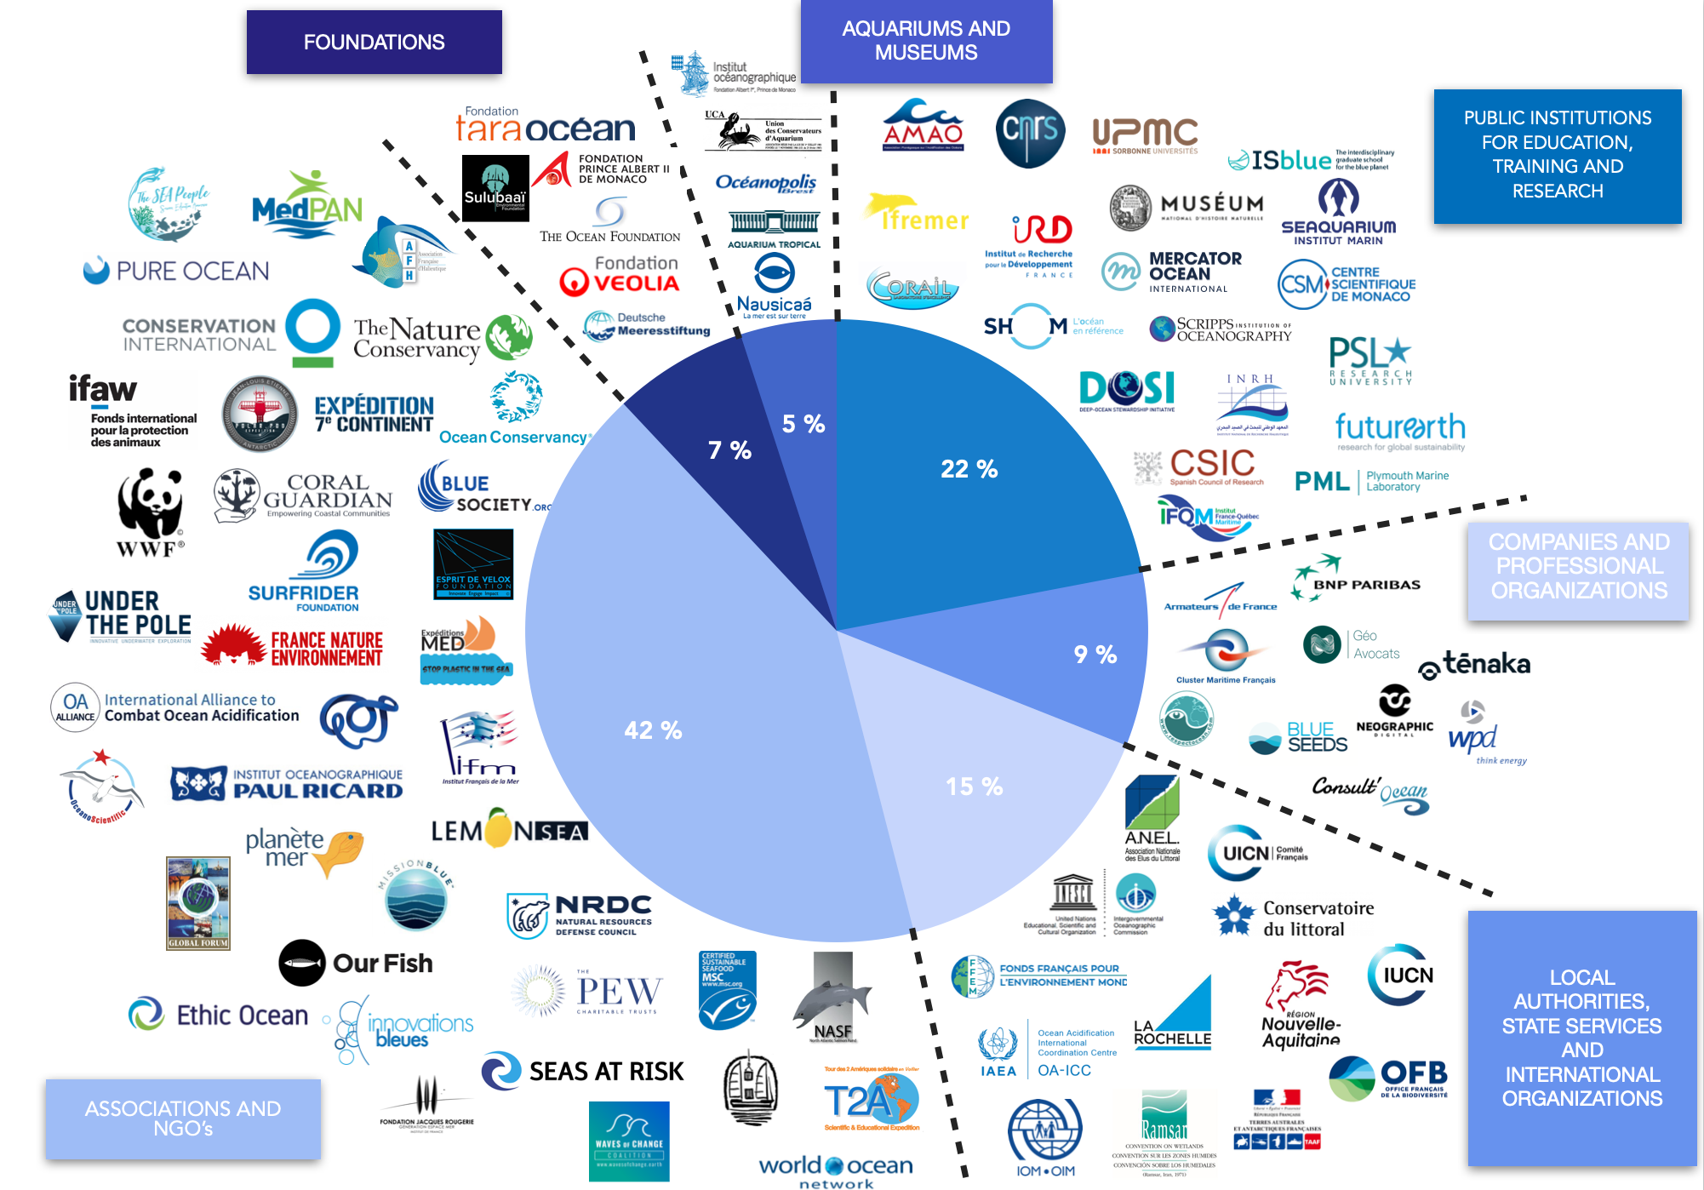
The Ocean & Climate Platform
Federates a network of 100 members around three axes:
Mobilisation
Sharing knowledge
Advocacy

Slide 3
Sea’ties initiative
Facilitating the development of sustainable public policies and the implementation of adaptation solutions for coastal cities threatened by sea level rise.
→ 5 regions of the world: Norther Europe, Mediterranean Basin, U.S. West Coast, West Africa, Pacific.
1
Gather and synthetize scientific knowledge and data
2
Foster the emergence of “good practices” and produce recommendations
3
Advocate for the integration of adaptation challenges into public poli­cies

Slide 4
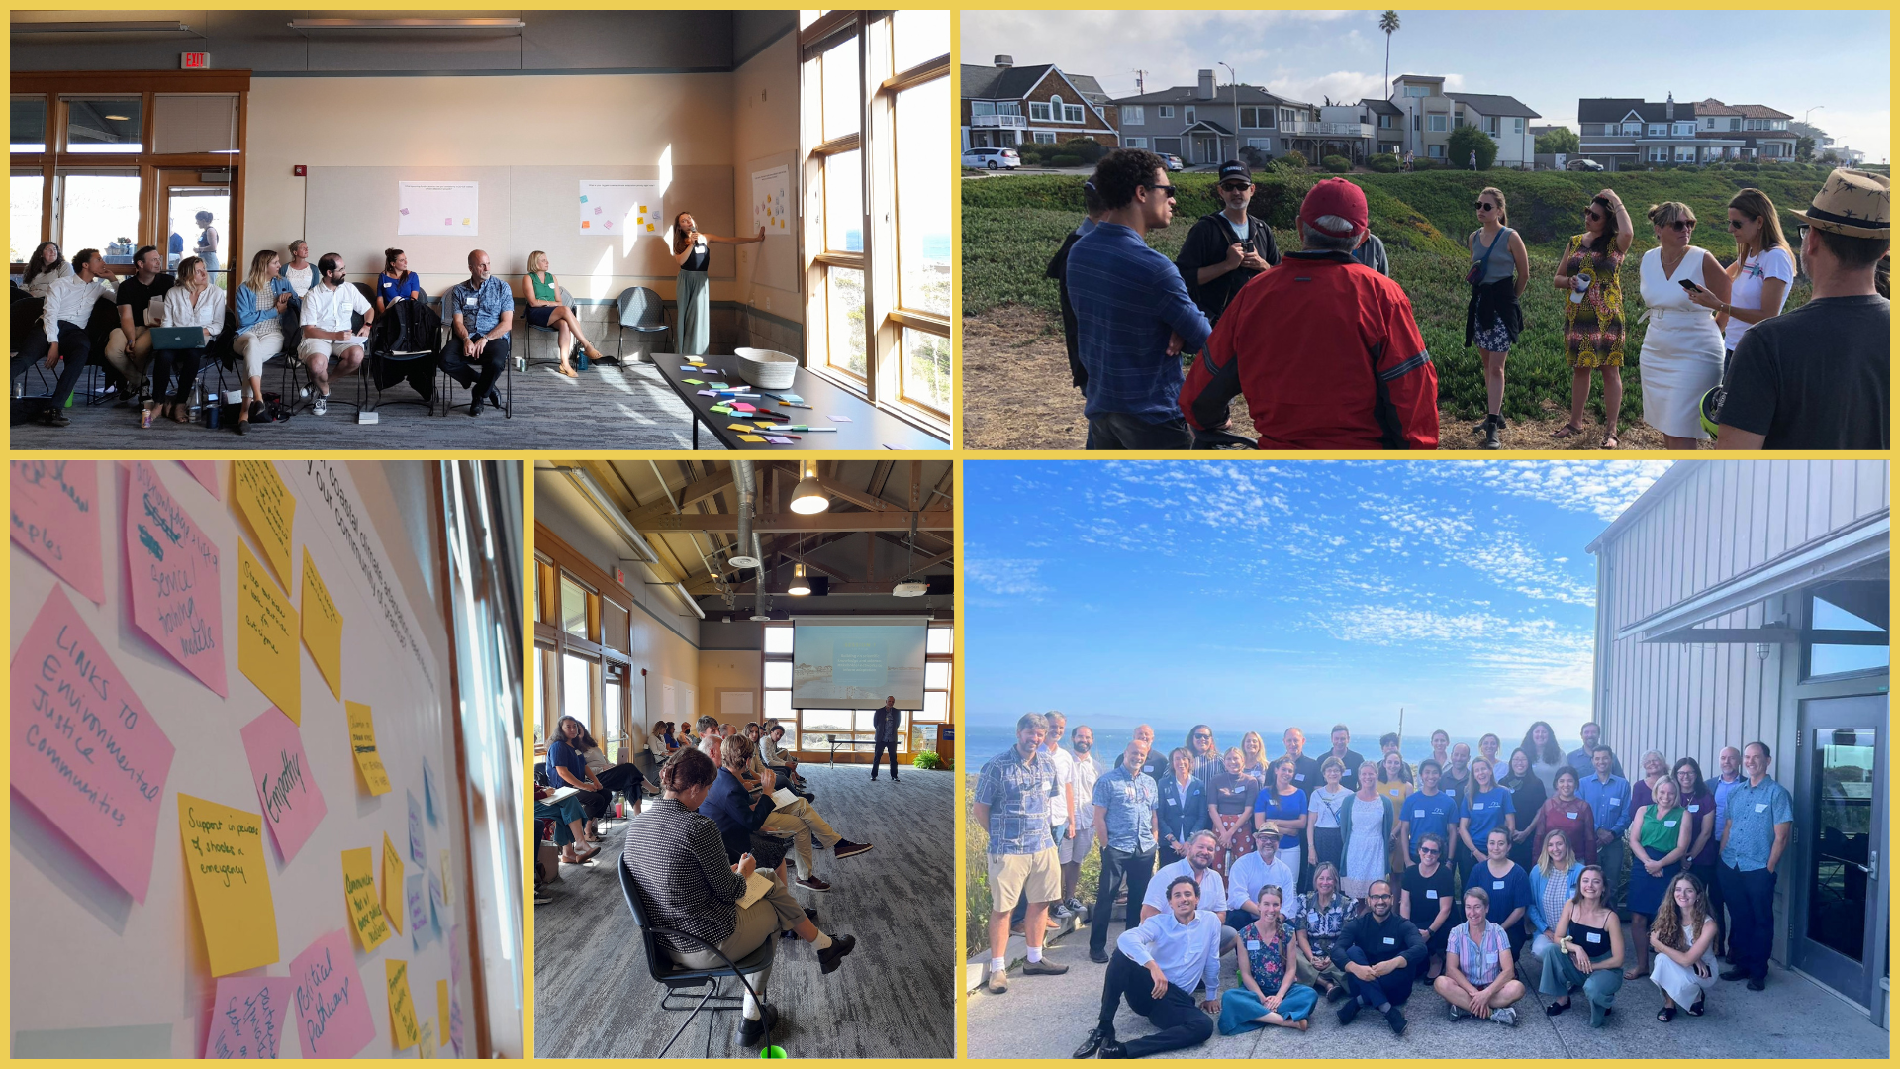
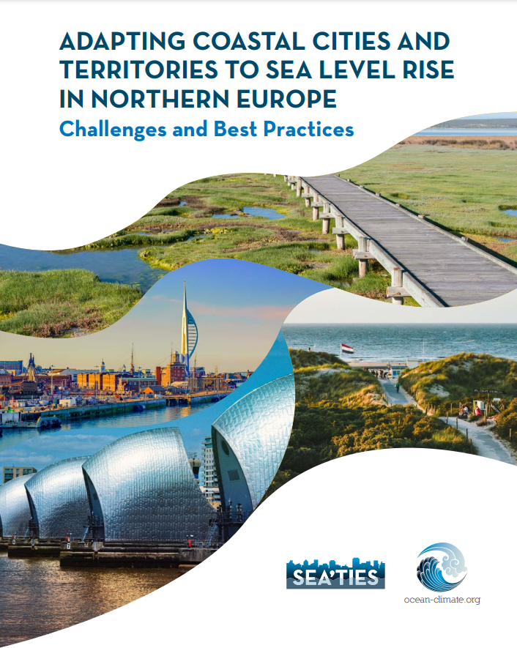
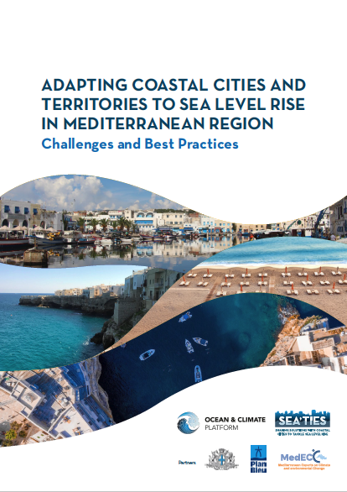
Pillars of adaptation
1) Actionable knowledge
Mobilizing scientific and non-scientific knowledge to produce readily accessible, downscaled information.
2) A systemic approach
Reinforcing territorial cohesion to implement dynamic, hybrid strategies.
3) Revaluing financing
Boosting public funding and private investments, and streamlining access.
4) Equity and social justice at heart

Slide 5
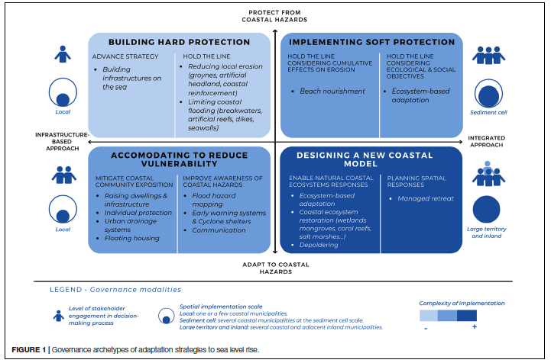
Involving communities in defining visions for just and equitable transitions
Visioning
Defining priorities for action, strategic objectives and what successful adaptation might look like.
Meaningful engagement
Innovative communication methods and partnerships.
Creating opportunities for effective and inclusive engagement.
→ Requires time + dedicated and re-evaluated funding.
Transformative action
Genuinely transformative solutions require community involvement.
→ Justice as legacy of adaptation.
Designing Coastal Adaptation Strategies to Tackle Sea Level Rise,
Bongarts Lebbe et al., 2021

Slide 6
Levers to accelerate adaptation action within cities
Creating groups for elected representatives to share experiences and solutions, and be informed by up-to-date scientific findings.
Raising awareness amongst communities through dedicated programmes

Slide 7
THANK YOU
Contact: Lisa Devignol, ldevignol@ocean-climate.org
Website: https://ocean-climate.org/en/seaties-2/

